Slide 1




CMSC204
Kartchner
V(StateGraph) = {Oregon, Alaska, Texas, Hawaii, Vermont, NewYork, California}
E(StateGraph) = {(Alaska, Oregon), (Hawaii, Alaska), (Hawaii, Texas), (Texas, Hawaii), (Hawaii, California), (Hawaii, New York), (Texas, Vermont), (Vermont, California), (Vermont, Alaska)}
1. Draw the StateGraph
Oregon
Alaska
Texas
Hawaii
Vermont
NewYork
California

Slide 2
a. Show the adjacency matrix that would describe the edges in the graph. Store the vertices in alphabetical order
States
Alaska | Cali | Ha | Ne | Or | Te | Ve
Alaska
California
Hawaii
New York
Oregon
Texas
Vermont
0 | 0 | 0 | 0 | 1 | 0 | 0
0 | 0 | 0 | 0 | 0 | 0 | 0
1 | 1 | 0 | 1 | 0 | 1 | 0
0 | 0 | 0 | 0 | 0 | 0 | 0
0 | 0 | 0 | 0 | 0 | 0 | 0
0 | 0 | 1 | 0 | 0 | 0 | 1
1 | 1 | 0 | 0 | 0 | 0 | 0
3. b. Show the adjacency lists
that would describe the edges in the graph
Alaska
California
Hawaii
New York
Oregon
Texas
Vermont
Oregon
Alaska California New York Texas Vermont
Hawaii Vermont
Alaska California

Slide 3
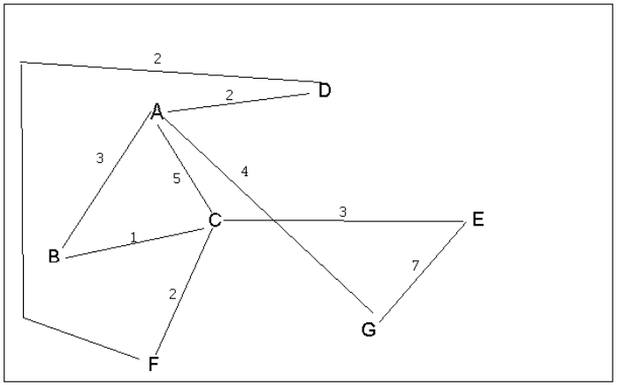
4 a. Which of the following lists the graph nodes in depth first order beginning with E?
A) E, G, F, C, D, B, A
B) G, A, E, C, B, F, D
C) E, G, A, D, F, C, B
D) E, C, F, B, A, D, G
4 b. Which of the following lists the graph nodes in breadth first order beginning at F?
A) F, C, D, A, B, E, G
B) F, D, C, A, B, C, G
C) F, C, D, B, G, A, E
D) a, b, and c are all breadth first traversals

Slide 4
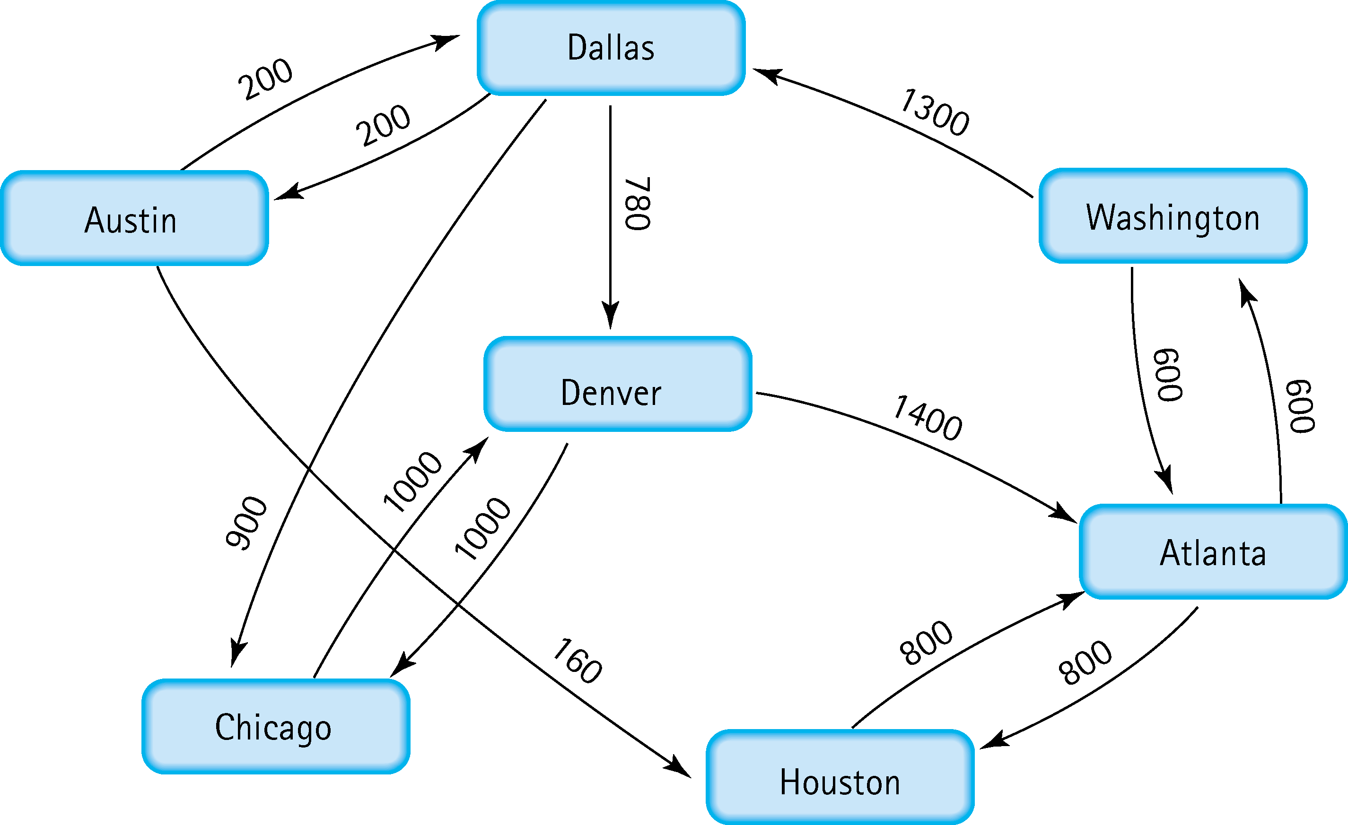
5. Find the shortest distance from Atlanta to every other city
Atlanta -Washington
Atlanta -Houston
Atlanta –Washington-Dallas
Atlanta –Washington-Dallas-Austin
Atlanta –Washington-Dallas-Denver
Atlanta –Washington-Dallas-Chicago

Slide 5
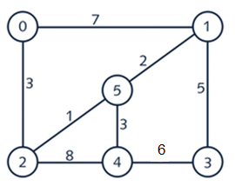
6. Find the minimal spanning tree using Prim’s algorithm. Use
0 as the source vertex . Show the steps.
{0,2}
{2,5}
{5,1}
{5,4}
{1,3}

Slide 6
7. Find the minimal spanning tree using Kruskal’s algorithm.
Show the weights in order and the steps.
{2,5}
{1,5}
{4,5}
{0,2}
{1,3}

Slide 7
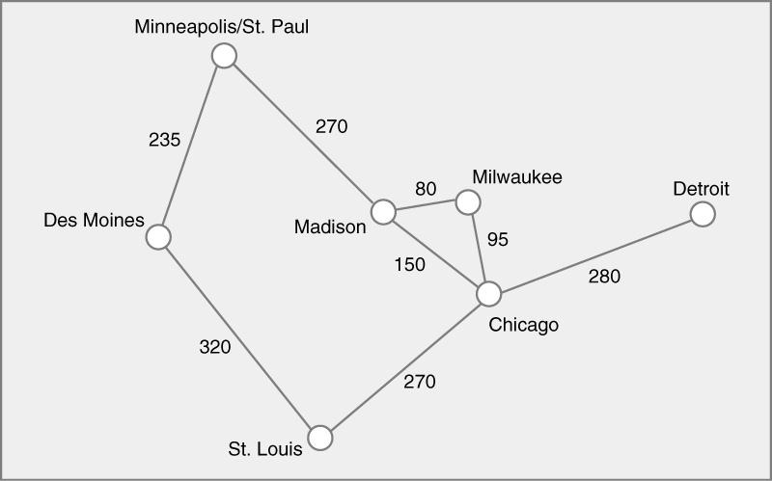
8. Find the minimal spanning tree using the algorithm you prefer. Use
Minneapolis/St. Paul as the source vertex
{Madison,Milwaukee}
{Milwaukee,Chicago}
{Minneapolis, Des Moines}
{Minneapolis, Madison}
{Chicago, St.Louis}
{Chicago, Detroit}

Slide 8
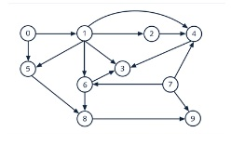
9. List the nodes of the graph in a breadth first topological ordering. Show the
steps using arrays predCount, topologicalOrder and a queue
0
7
5
1
4
2
3
6
8
9

Slide 9

10. List the nodes of the graph in a breadth first topological ordering.
Start
Discrete Math
Programming 1
Programming 2
Computer Organization
Algorithms
High Level languages
Theory of Computation
Operating Systems
Compilers
Senior Seminar
End

